Slide 1
Consumer Behavior Analytics
Francis Troy Kirinhakone
Carlos He He

Slide 2

Dataset
Brazilian E-commerce Public Dataset by Olist
Contains over 100,000 orders with product, customer, and reviews info.

Slide 3
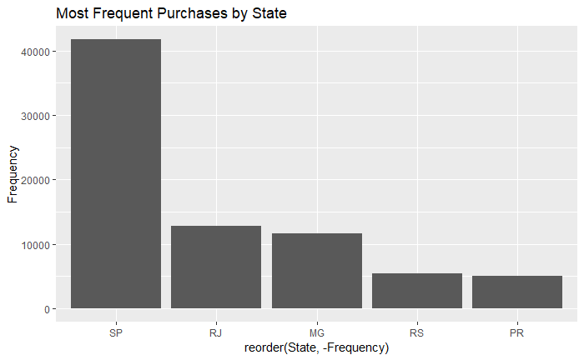
Exploratory Data Analysis
Discovered the most frequent purchases by states.

Slide 4
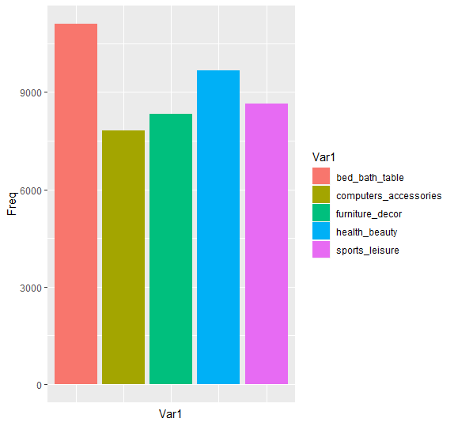
Exploratory Data Analysis
Discovered most frequent bought products by category.

Slide 5
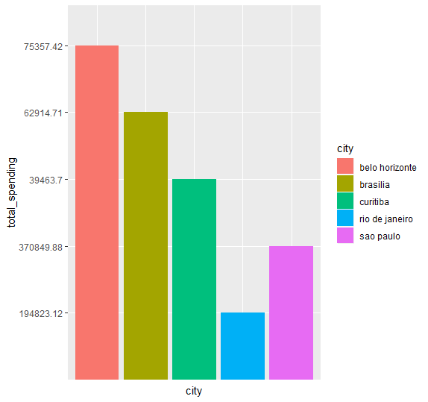
Exploratory Data Analysis
Total spending of each city.

Slide 6
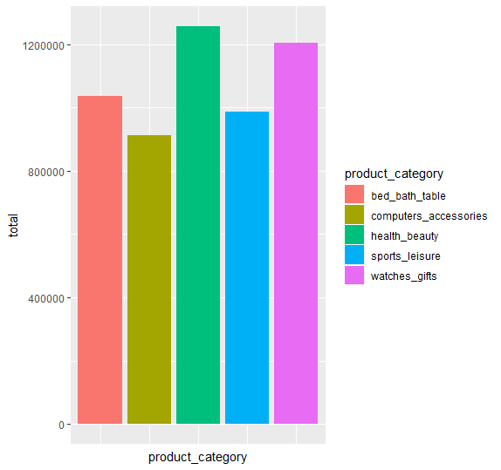
Exploratory Data Analysis
Total spending for each category.

Slide 8
Prospective Usage
Prospecting small businesses.
Businesses can provide promotions on the least frequent products in their respective areas to boost sales.

